Slide 1


Generation SG JDE05 Interim Project
Members
Daniel, Pin Pin Yvonne, Pin Yeen Erica, Shawn
DPPS

Slide 2


Objective
Local favourite: Air tickets before and after COVID
Pursued several sources like Amadeus, Trip.com, Booking.com, Singapore Airlines, Agoda, Expedia etc.
None provided historical prices, only booking of flight and lodging

Slide 3

Further brainstorming
Another local favourite: Resale HDB
Decided on DATA.Gov.SG API/Data
Comprehensive data and 100% Singapore context

Slide 4

Problem Statement
To buy a flat at the coolest area in Singapore, at the best price

Slide 5

Data needed for analysis
Air temperature
Humidity
Resale HDB transaction prices

Slide 6
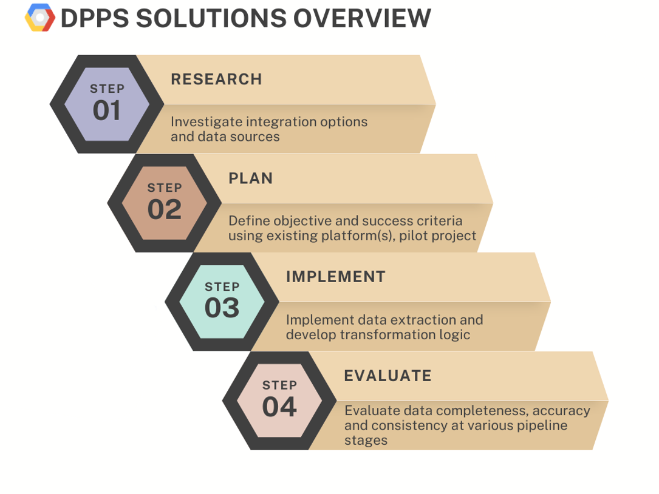

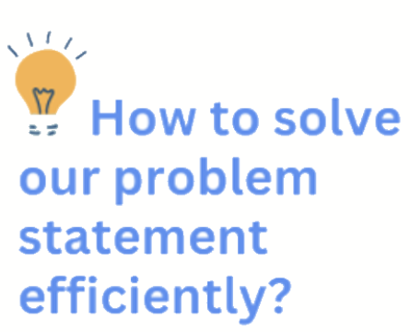
Problem solving framework

Slide 7

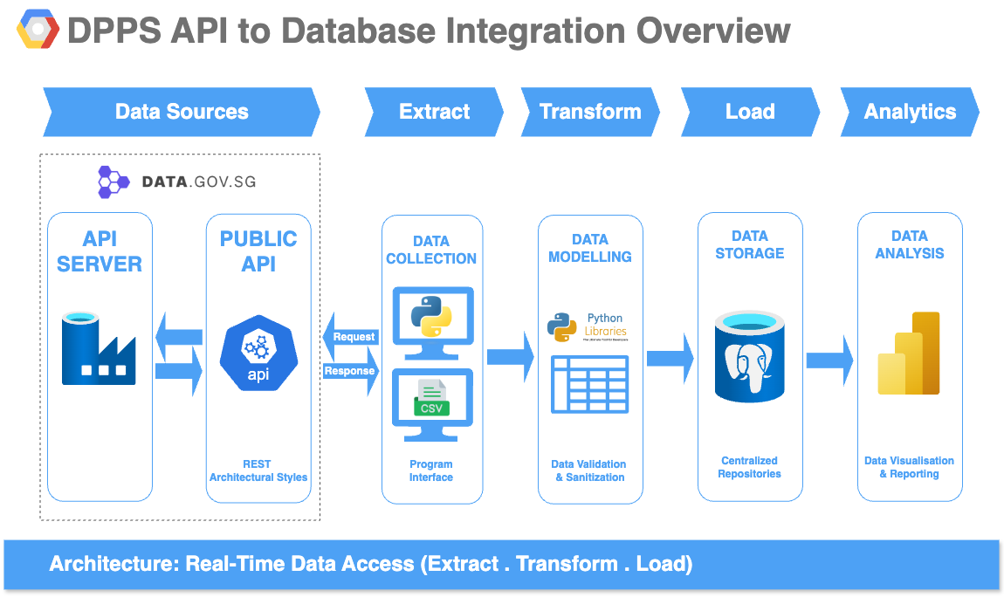

Slide 8
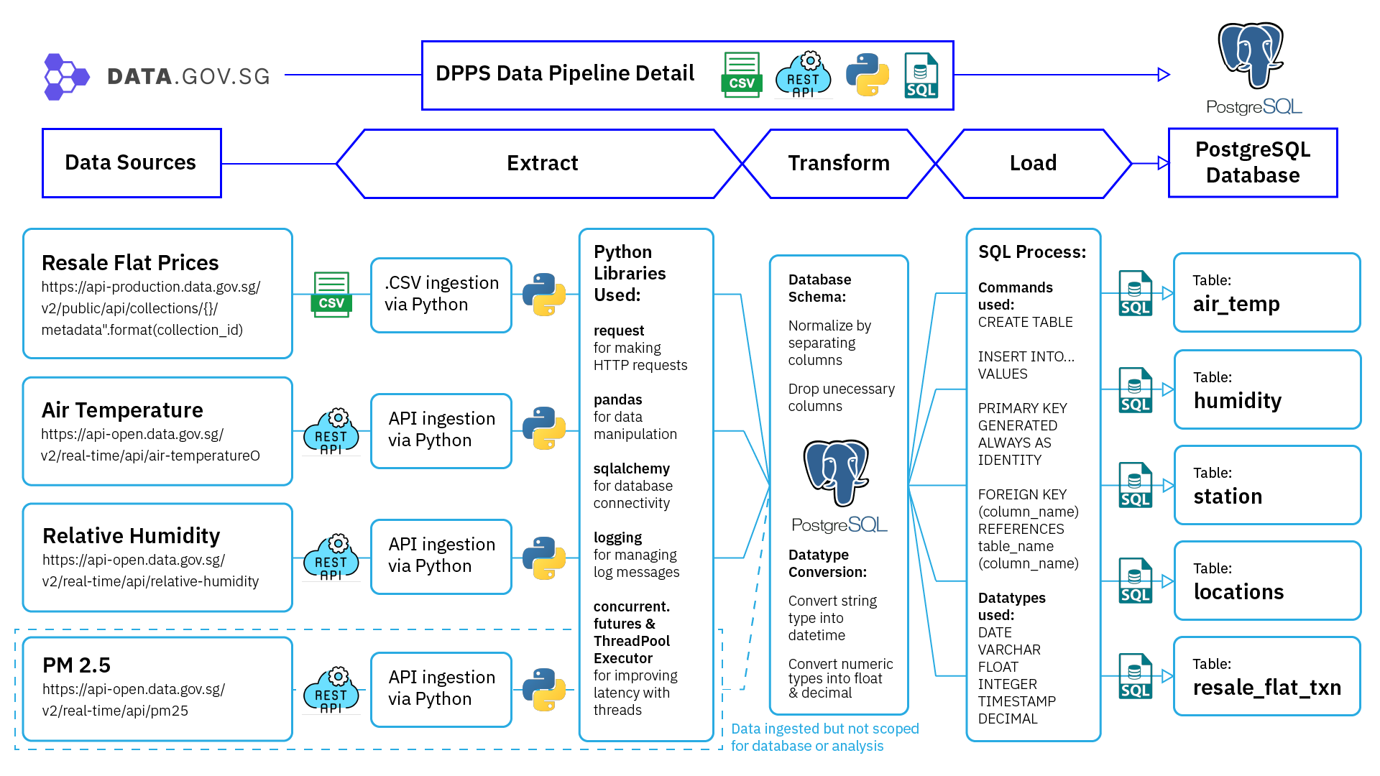

Slide 9


Extract
NEA API https://api.data.gov.sg/v1/environment/air-temperature https://api-open.data.gov.sg/v2/real-time/api/relative-humidity
HDB CSV https://api-production.data.gov.sg/v2/public/api/datasets
Air temperature readings
Humidity readings
HDB transaction prices
DATA.GOV.SG

Slide 10
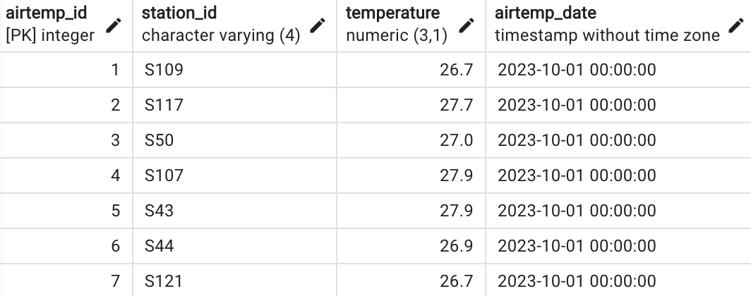
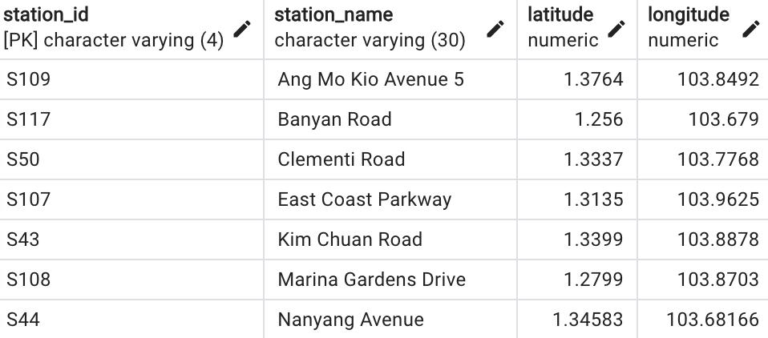
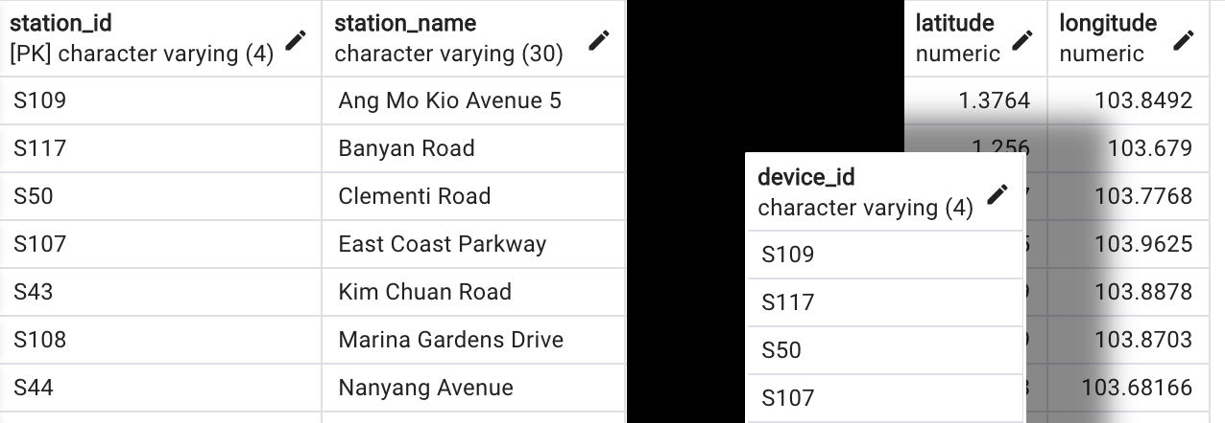
Transform
Data normalisation to reduce redundancy
Split JSON data to different data frames to remove repetition
Drop unnecessary columns
Filter out outliers or incomplete data

Slide 11
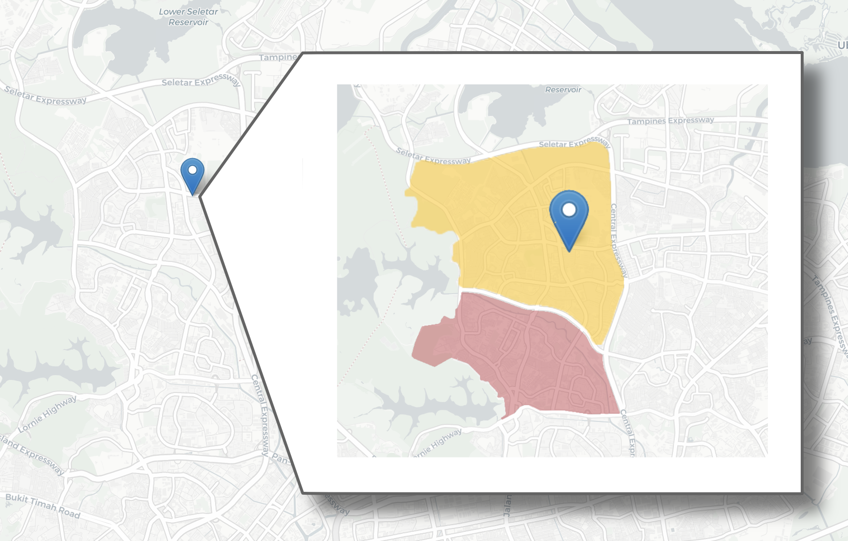

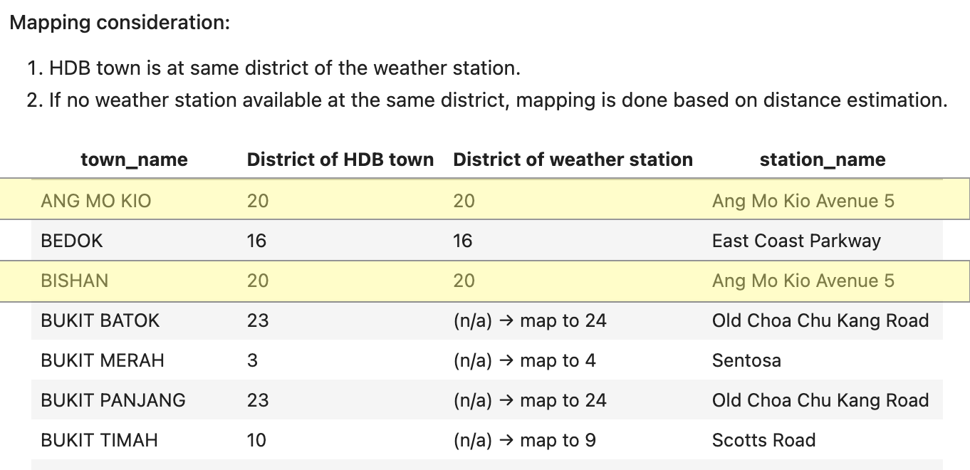
Mapping HDB towns to weather stations
Ang Mo Kio ave 5 station
Ang Mo Kio town
Bishan town

Slide 12

Load
Move data into project database
Database consists of five tables: weather station locations, humidity, air temperature, HDB resale prices, mapped HDB town-weather station
PM2.5 table is available for future analysis

Slide 13
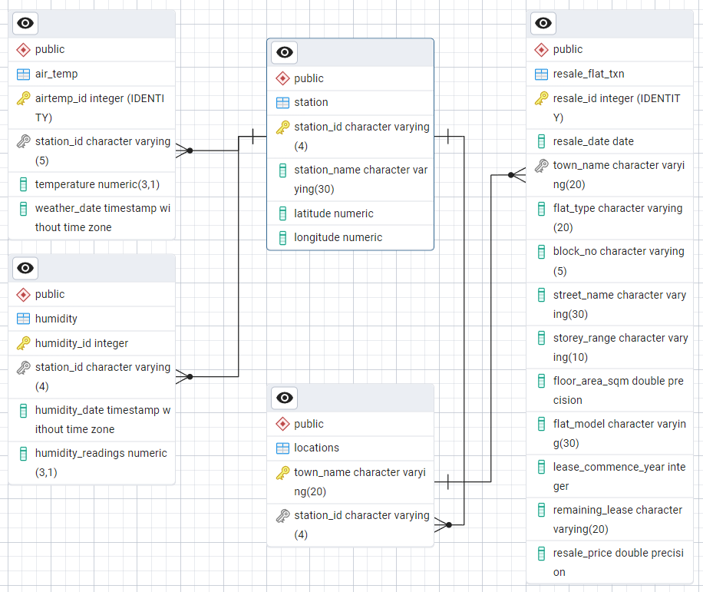
Entity Relationship Diagram
Database Model: Relational Model
Future Consideration: Dimensional Galaxy Model to further reduce dependencies and redunduncies

Slide 14

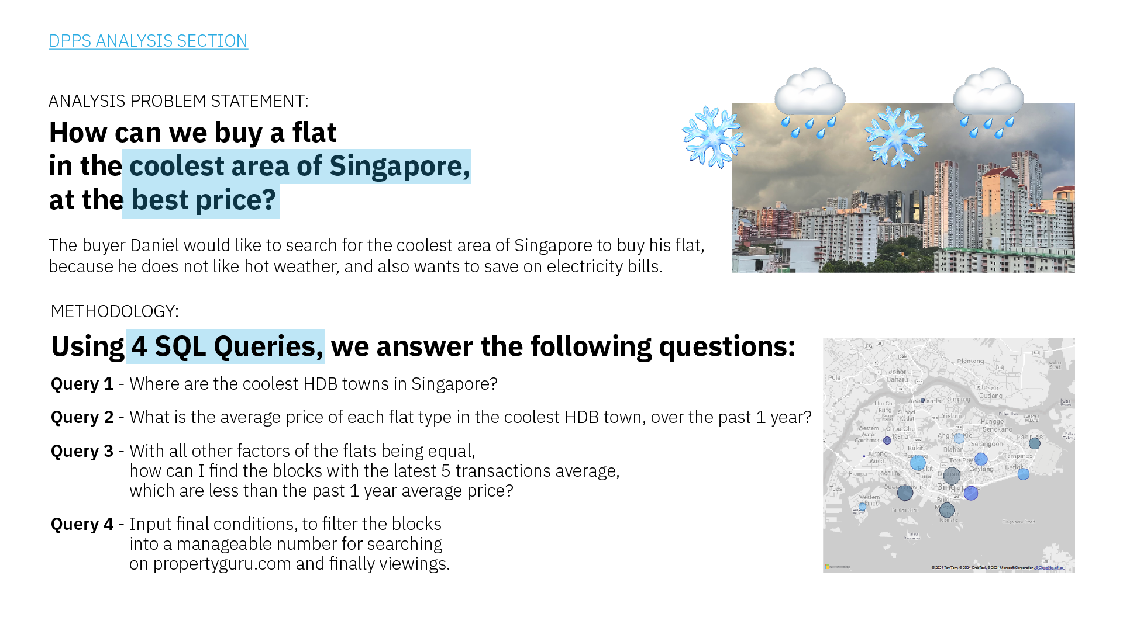

Slide 15
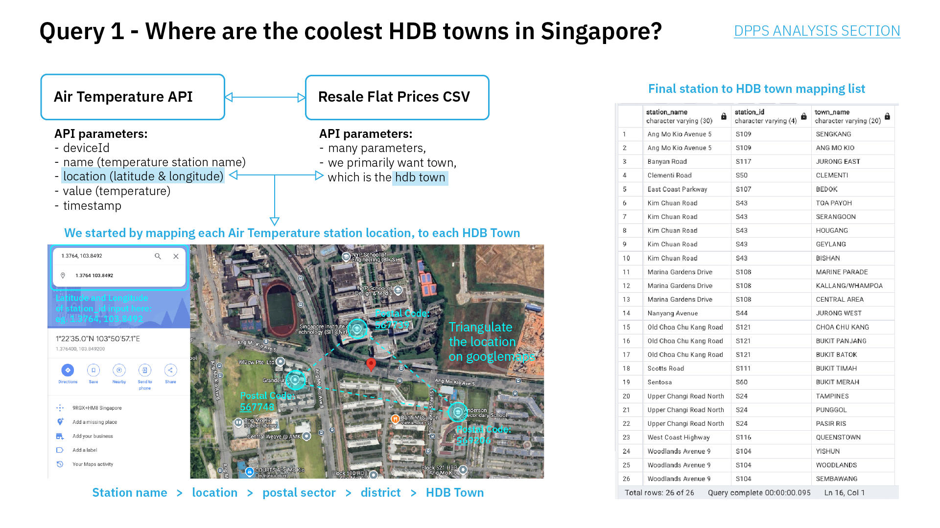

Slide 16
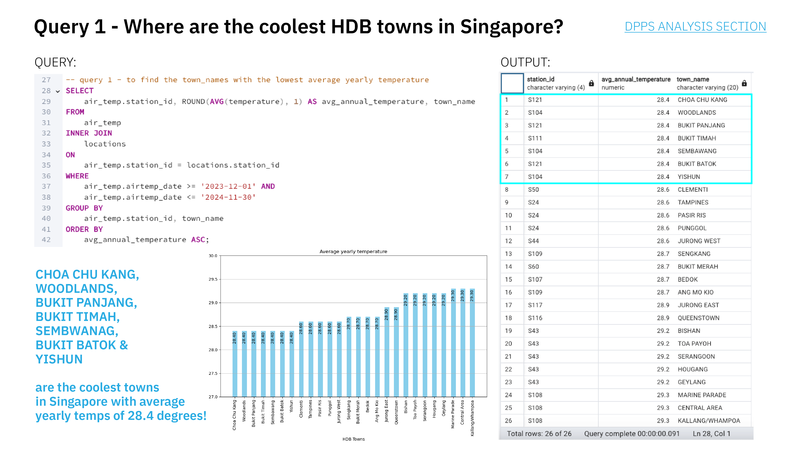

Slide 17
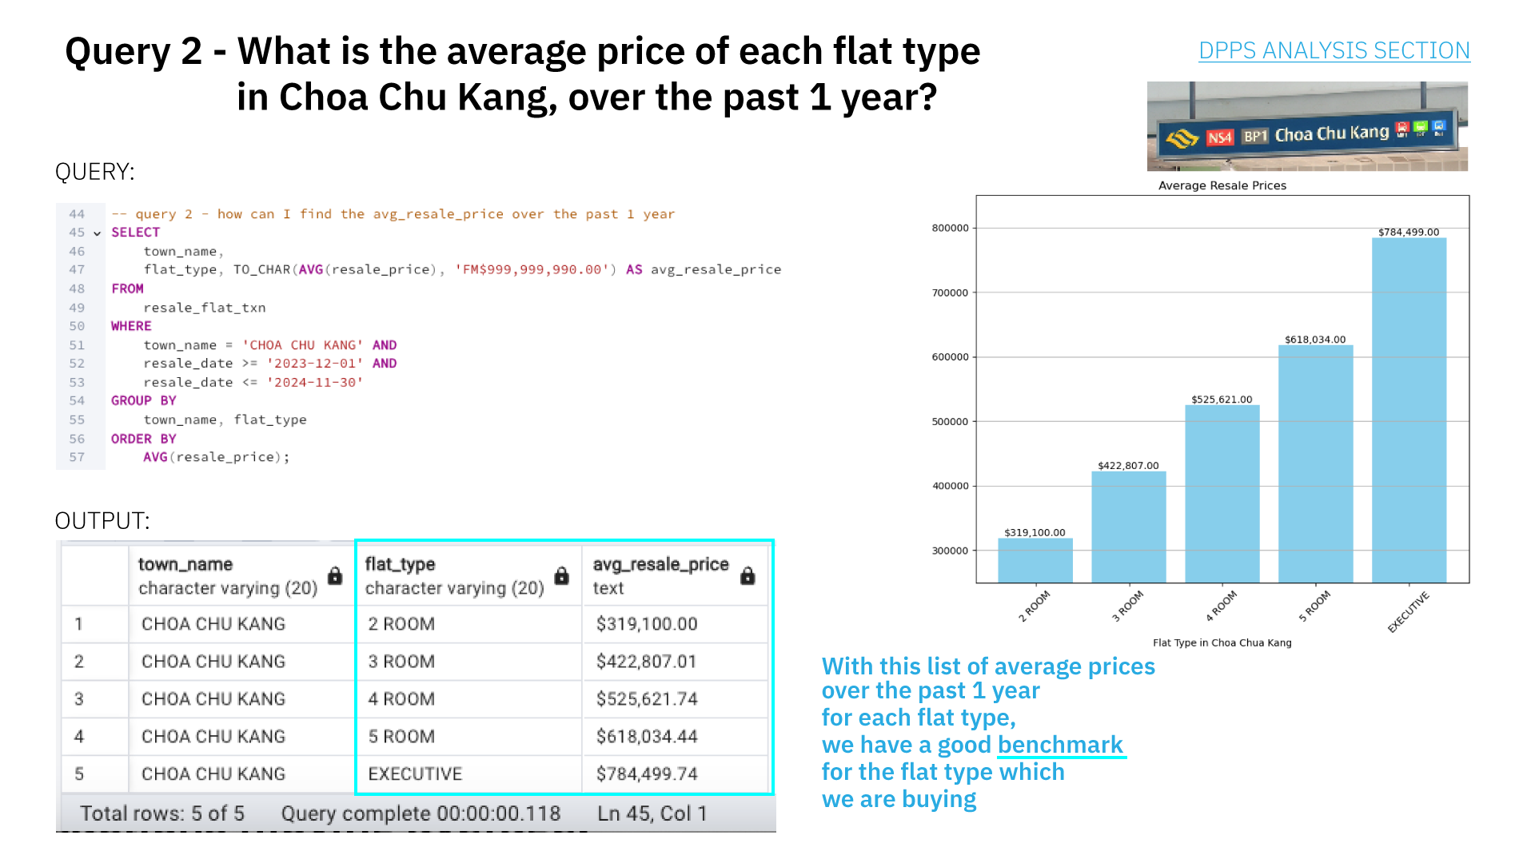

Slide 18
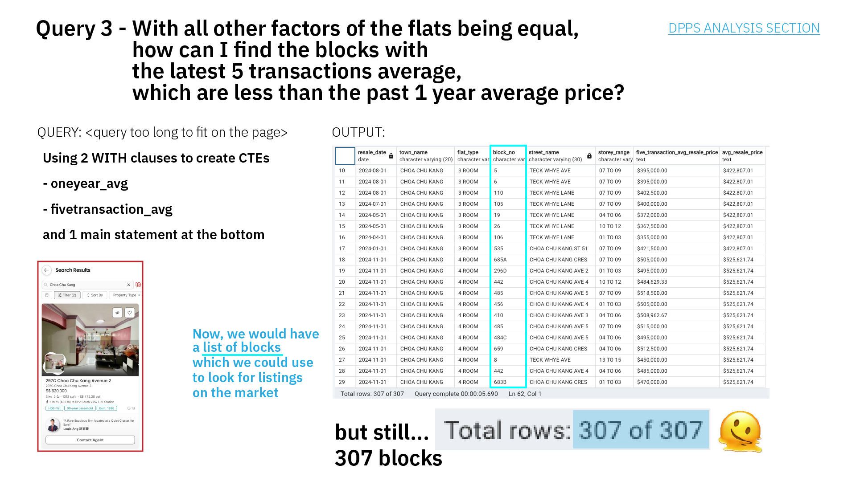

Slide 19
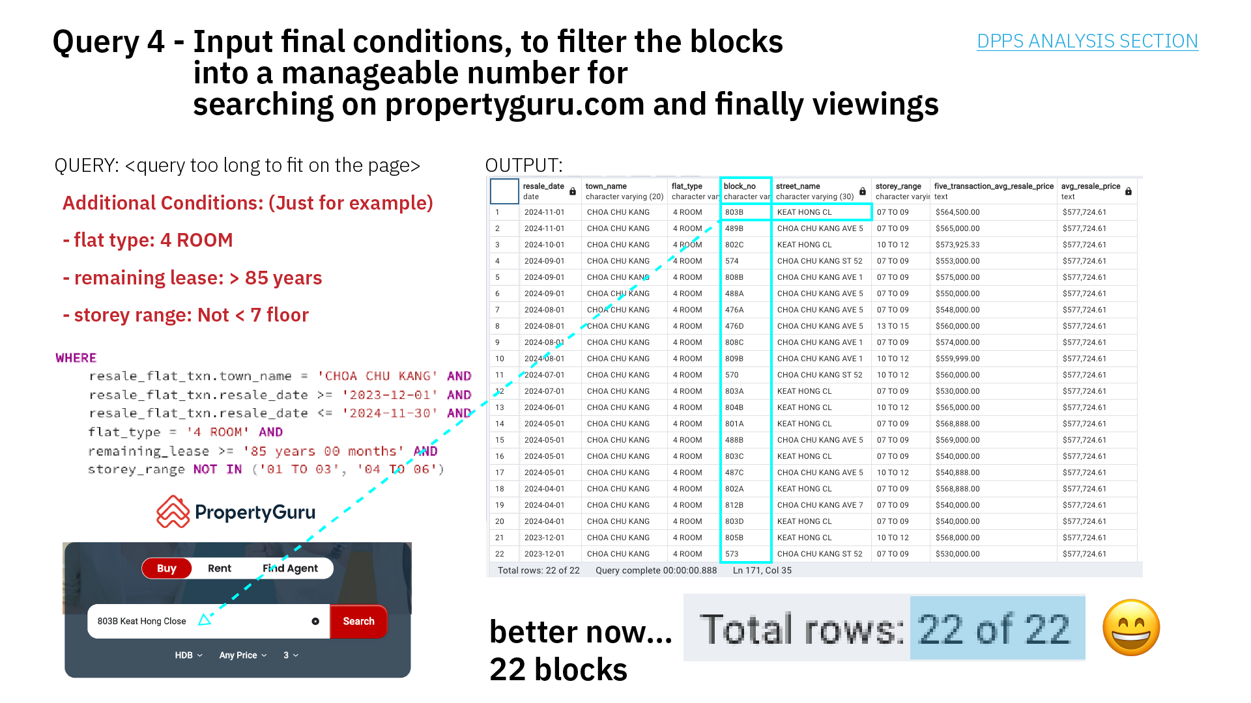


Slide 20
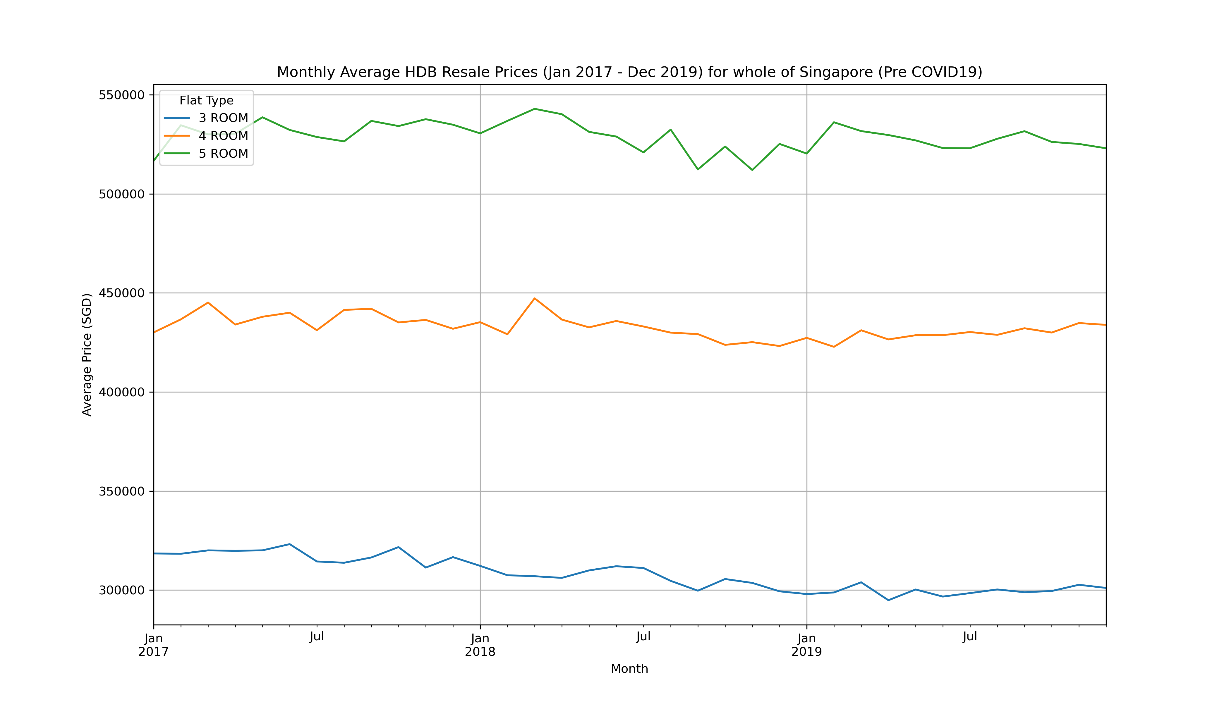
Did COVID19 affect resale prices?
You may be wondering …
Monthly Average HDB Resale Prices (Jan 2017-Dec 2019) for whole of Singapore (Pre COVID19)

Slide 21
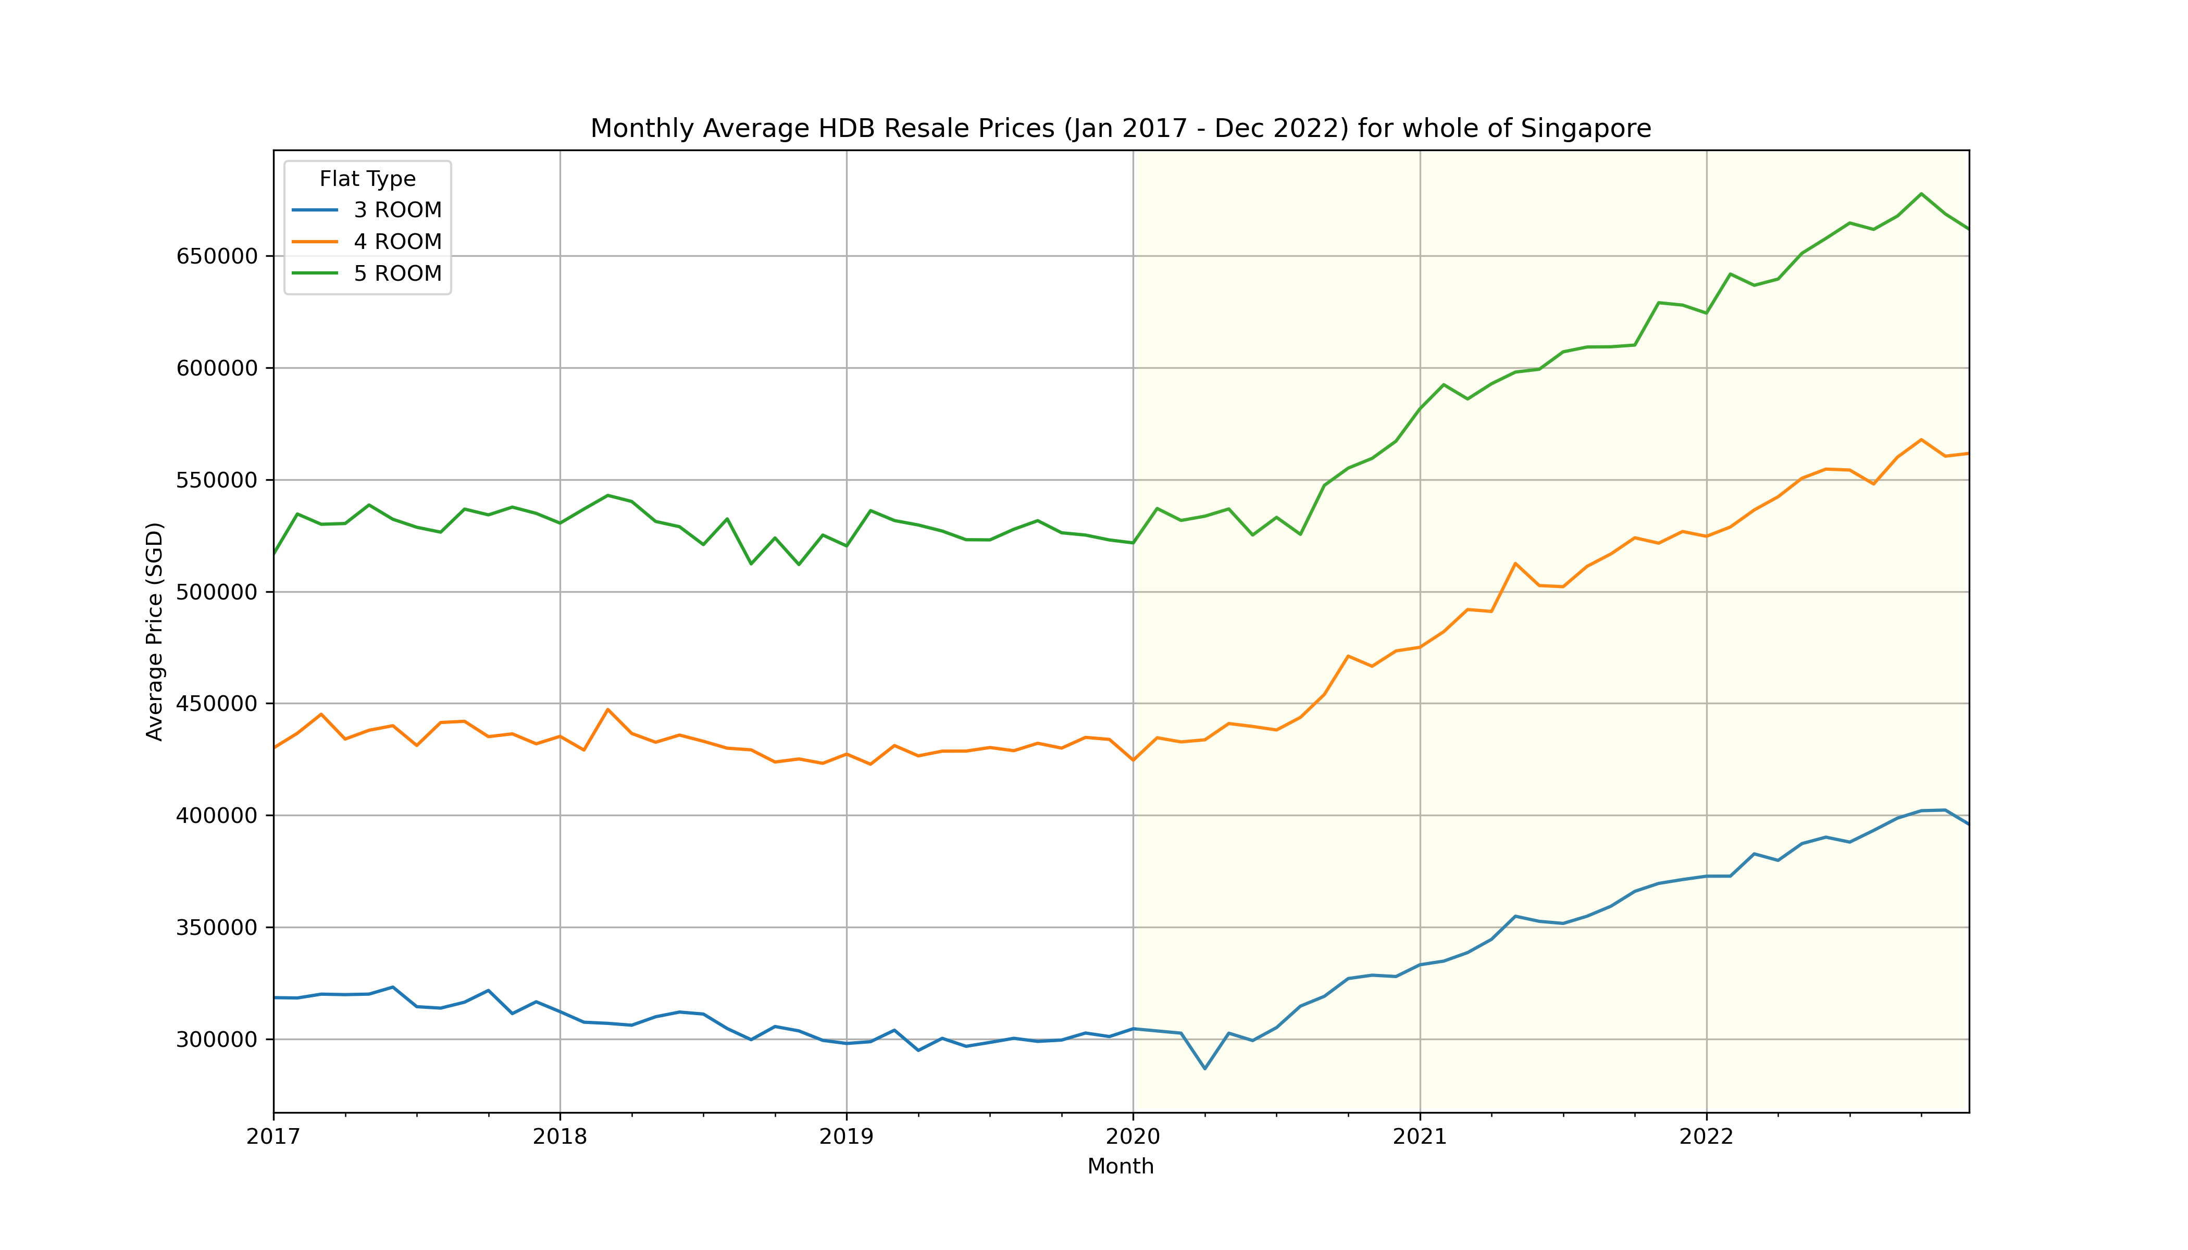
Is it possible to find out? Does anyone know?
Monthly Average HDB Resale Prices (Jan 2017- Dec 2022) for whole of Singapore (COVID19 incl.)

Slide 22
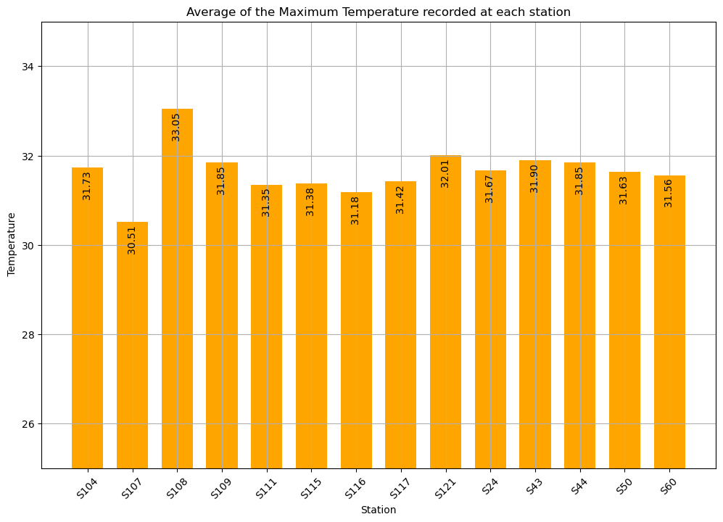
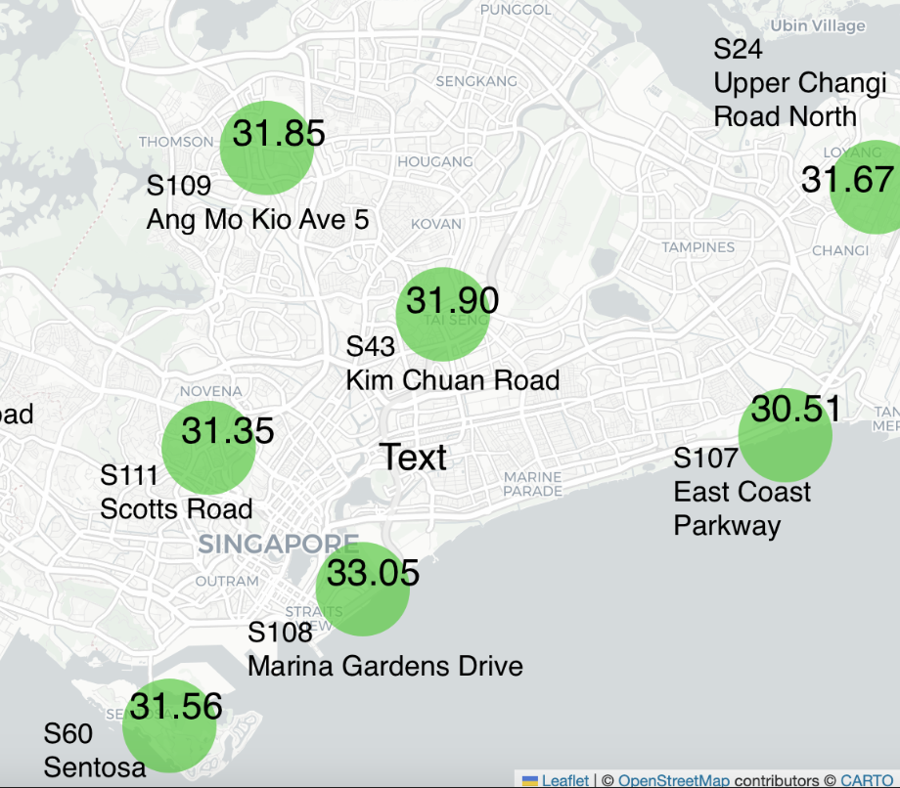
Only the hottest readings…

Slide 23

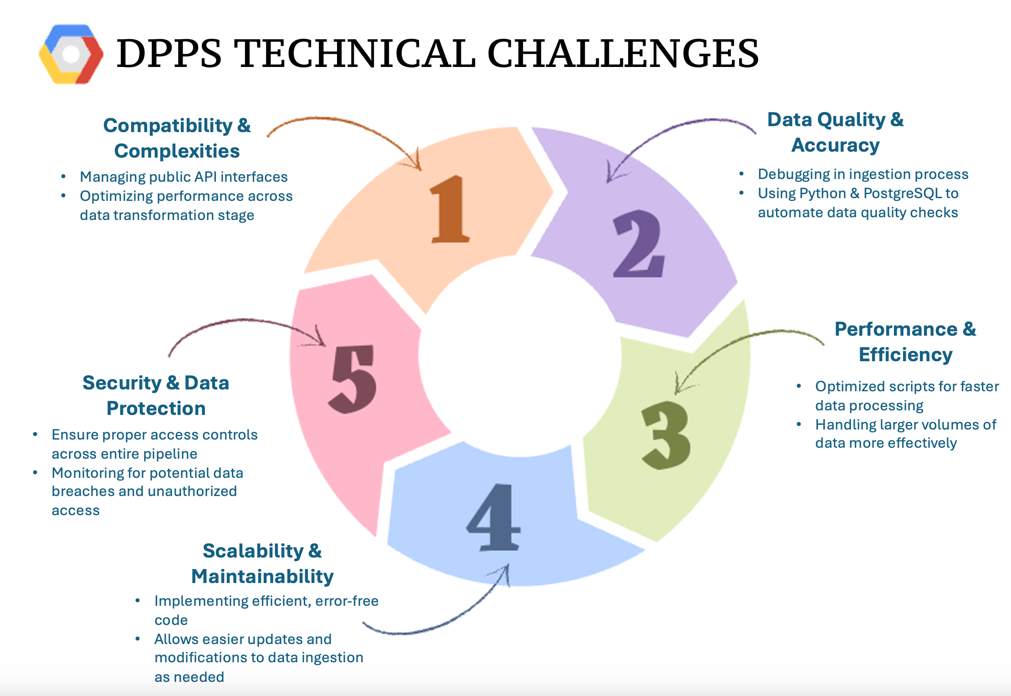

Slide 24
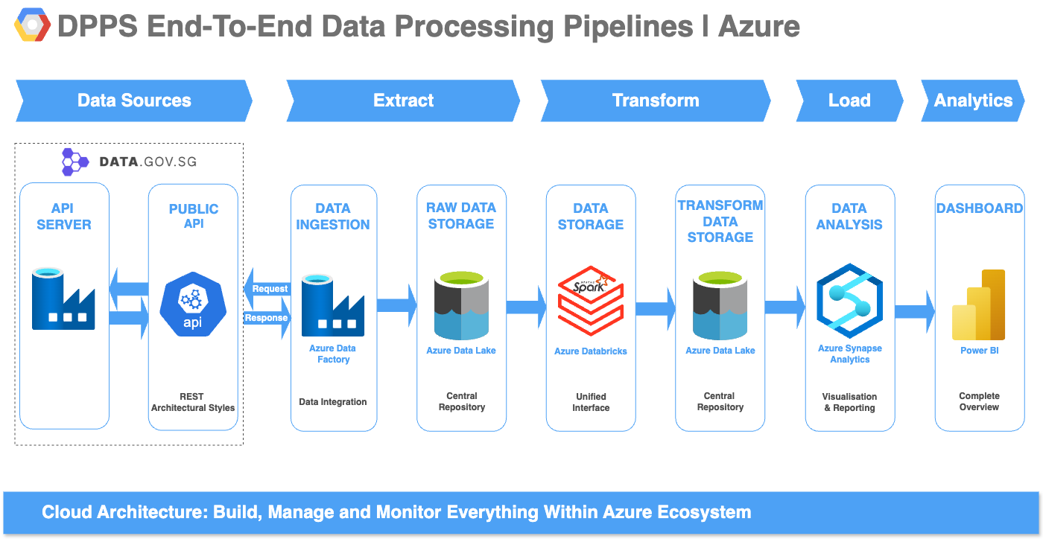

Slide 25
The END

